Slide 1
Module 3 – Project 8
Radek Debek,
Ouykhy Quach,
Maher Zeghida
Machine Learning algorithm
Feb 7, 2022

Slide 2
Overview
Data from May 2014 related to Uber trip in NYC
Goal is to find the optimal number of clusters to provide recommendations on where drivers should be to maximize their chances of finding a ride
Methods used:
Kmeans
DBSCAN
Agglomerative clustering
Optics
Means_shift

Slide 3
Models results comparison
 | n_clusters | Silhouette Coefficient | Variance Ratio Criterion | Davides Bouldin score
kmeans | 5.0 | 0.4303 | 39927.7614 | 0.6768
Agglomerative Clustering | 5.0 | 0.4291 | 36744.3000 | 0.6799
DBSCAN | 11.0 | 0.2173 | 4126.1367 | 2.0523
Optics | 4094.0 | -0.0477 | 20.5648 | 1.7494
Means shift | 84.0 | 0.5004 | 2319.9372 | 0.5012

Slide 4
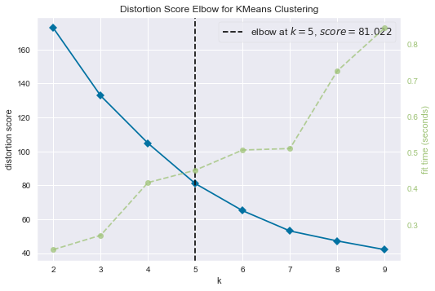
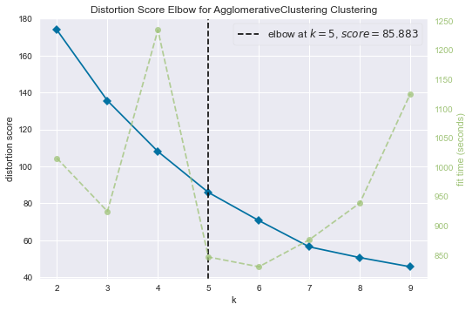
Elbow method for Kmeans and Agglomerative Clustering

Slide 5
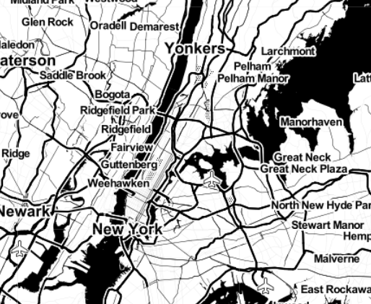
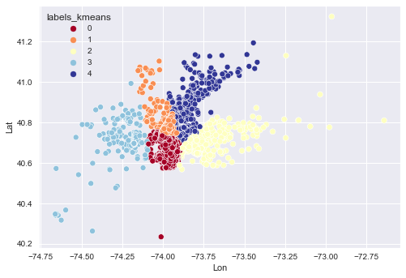
Models implementation 5 clusters
Kmeans

Slide 6
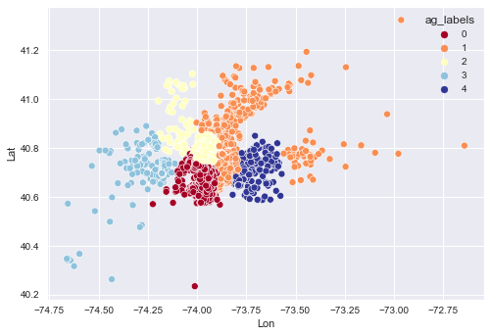
Models implementation 5 clusters
Agglomerative Clustering

Slide 7
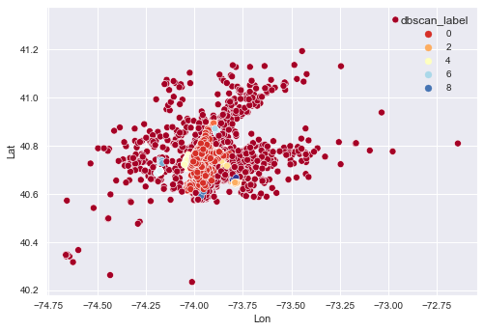
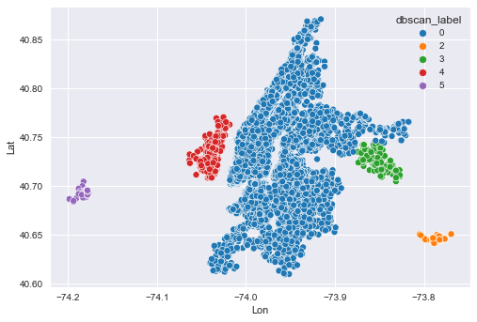
Models implementation DBSCAN
All clusters
Top 5 most populated

Slide 8
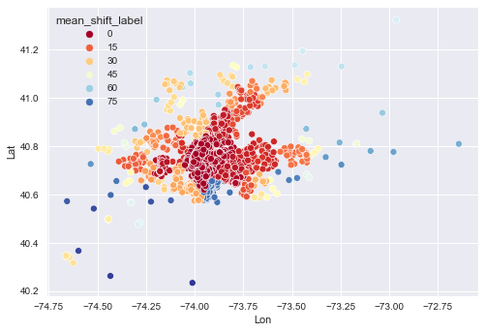
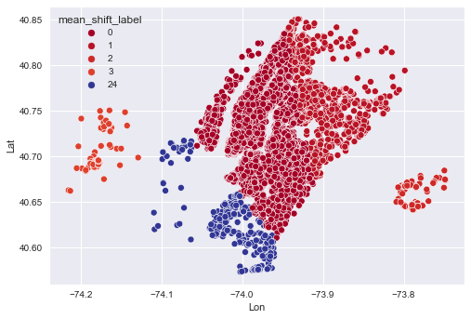
Models implementation Mean shift
All clusters
Top 5 most populated

Slide 9
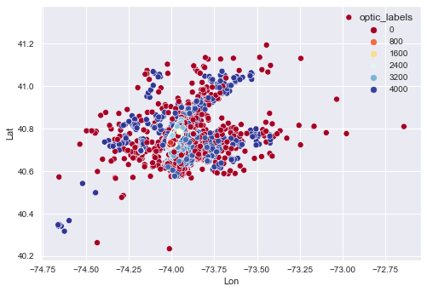
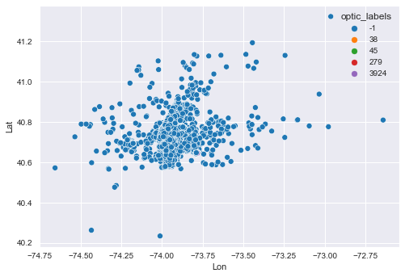
Models implementation OPTICS
All clusters
Top 5 most populated

Slide 10
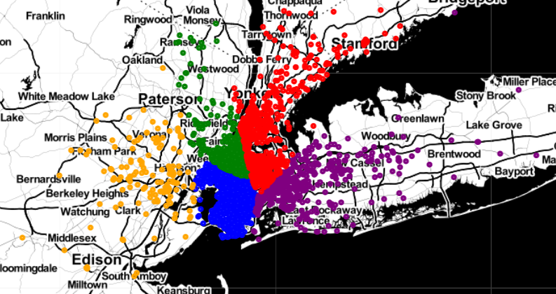
Dashboard

Slide 11
Q&A
Thank you

